Slide 1








DOM, jQuery and AJAX
DOM, jQuery, AJAX, REST
Using Kinvey as JS Back-End
jQuery and AJAX
SoftUni Team
Technical Trainers
Software University
http://softuni.bg

Slide 2



Table of Contents
Introduction to DOM
jQuery Basics
HTTP Basics
RESTful Services
AJAX and jQuery AJAX
Using Kinvey as JS Back-End

Slide 3
Have a Question?
sli.do #4712

Slide 4
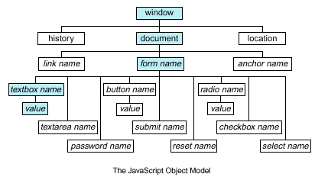
Document Object Model (DOM)
DOM represents HTML document as a tree of elements

Slide 5
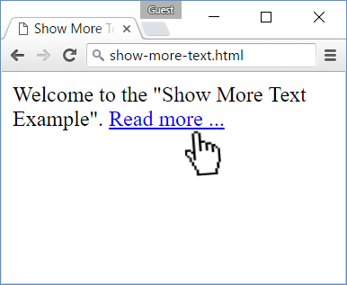
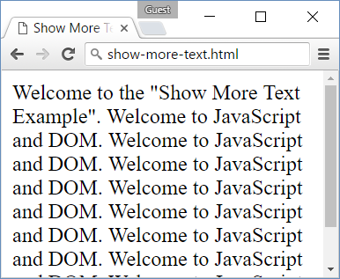
Problem: Show More Text
Create HTML page holding short text + link "Read more …"
Clicking on the link shows more text and hides the link

Slide 6

Solution: Show More Text
Welcome to the "Show More Text Example". <a href="#" id="more" onclick="showText()">Read more …</a>
<span id="text" style="display:none">Welcome to …</span>
<script>
function showText() {
document.getElementById('text')
.style.display = 'inline';
document.getElementById('more')
.style.display = 'none';
}
</script>
See the DOM tree here: http://software.hixie.ch/utilities/js/live-dom-viewer/?saved=4275

Slide 7
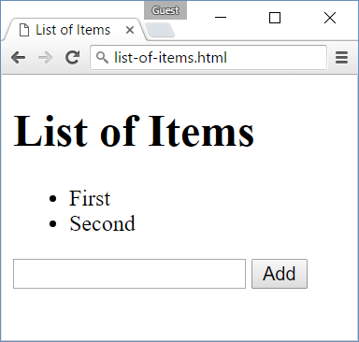
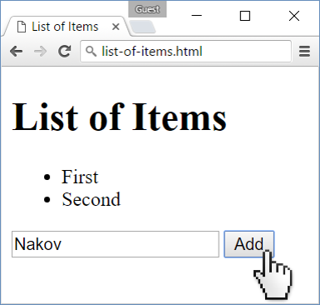
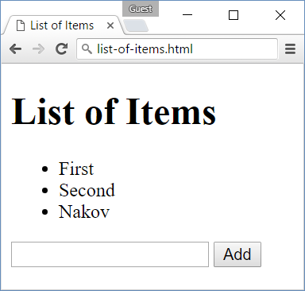
Problem: List of Items
Create a HTML page holding a list of items + text box + button for adding more items to the list

Slide 8
Solution: List of Items
<h1>List of Items</h1>
<ul id="items"><li>First</li><li>Second</li></ul>
<input type="text" id="newItemText" />
<input type="button" onclick="addItem()" value="Add">
<script>
function addItem() {
let text = document.getElementById('newItemText').value;
var li = document.createElement("li");
li.appendChild(document.createTextNode(text));
document.getElementById("items").appendChild(li);
}
</script>

Slide 9
jQuery
jQuery is a cross-browser JavaScript library
Dramatically simplifies DOM manipulation
Simplifies AJAX calls and working with RESTful services
Free, open-source software: https://jquery.com
<script src="https://code.jquery.com/jquery-3.0.0.min.js"></script>
Load jQuery from its official CDN
$('li').css('background', '#DDD');
Change the CSS for all <li> tags

Slide 10
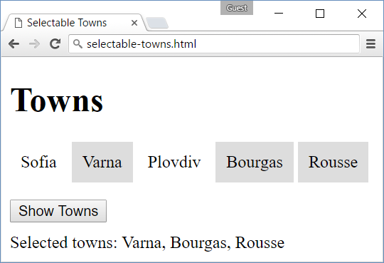
Problem: Selectable Towns
Create a HTML page listing towns
Clicking on a town should select / deselect it
A button shows all selected towns
<html><head>
<script src="https://code.jquery.com/jquery-3.0.0.min.js"></script><style>li { … }</style></head>
…
<ul id="items"><li>Sofia</li><li>Varna</li>…</ul>

Slide 11
Solution: Selectable Towns
Attach JS event handler for each <li> element
<script>
$('#items li').click(function() {
let li = $(this);
if (li.attr('data-selected')) {
li.removeAttr('data-selected')
li.css('background', '')
} else {
li.attr('data-selected', 'true')
li.css('background', '#DDD')
}
})
</script>
$(this) holds the clicked <li>
Attach attribute 'data-selected' = 'true' to each selected <li>

Slide 12
Solution: Selectable Towns
<button id="showTownsButton">Show Towns</button>
<script>
$('#showTownsButton').click(function() {
let selectedLi = $('#items li[data-selected=true]')
let towns = selectedLi.map((i, x) => x.innerText)
.get().join(', ')
let townsDiv =
$('<div>').text("Selected towns: " + towns)
$('body').append(townsDiv)
})
</script>
Select innerText from all <li>
Append a new <div> at the end of the HTML body

Slide 13

Playing with DOM and jQuery
Live Exercises in Class (Lab)

Slide 14


HTTP Basics
HTTP (Hyper Text Transfer Protocol)
Text-based client-server protocol for the Internet
For transferring Web resources (HTML files, images, styles, etc.)
HTTP request
HTTP response
Web Server

Slide 15
HTTP Request Methods
HTTP defines methods to indicate the desired action to be performed on the identified resource
Method | Description
GET | Retrieve / load a resource
POST | Create / store a resource
PUT | Update a resource
DELETE | Remove a resource
PATCH | Update resource partially
HEAD | Retrieve the resource's headers

Slide 16
HTTP GET Request – Example
Example of HTTP GET request:
HTTP request line
GET /courses/javascript HTTP/1.1
Host: www.softuni.bg
Accept: */*
Accept-Language: bg
Accept-Encoding: gzip, deflate
Mozilla/5.0 (Windows NT 10.0) Chrome/51.0.2704.103
Connection: Keep-Alive
Cache-Control: no-cache
<CRLF>
HTTP headers
The request body is empty

Slide 17
HTTP POST Request – Example
Example of HTTP POST request:
HTTP request line
POST /webmail/login.phtml HTTP/1.1
Host: www.abv.bg
Accept: */*
Accept-Language: bg
Accept-Encoding: gzip, deflate
User-Agent: Mozilla/4.0(compatible;MSIE 6.0; Windows NT 5.0)
Connection: Keep-Alive
Cache-Control: no-cache
Content-Length: 59
<CRLF>
LOGIN_USER=mente
DOMAIN_NAME=abv.bg
LOGIN_PASS=top*secret!
<CRLF>
HTTP headers
The request body holds the submitted data

Slide 18
HTTP Response – Example
Example of HTTP response from the Web server:
HTTP response status line
HTTP/1.1 200 OK
Date: Fri, 17 Jul 2010 16:09:18 GMT+2
Server: Apache/2.2.14 (Linux)
Accept-Ranges: bytes
Content-Length: 84
Content-Type: text/html
<CRLF>
<html>
<head><title>Test</title></head>
<body>Test HTML page.</body>
</html>
HTTP response headers
HTTP response body

Slide 19
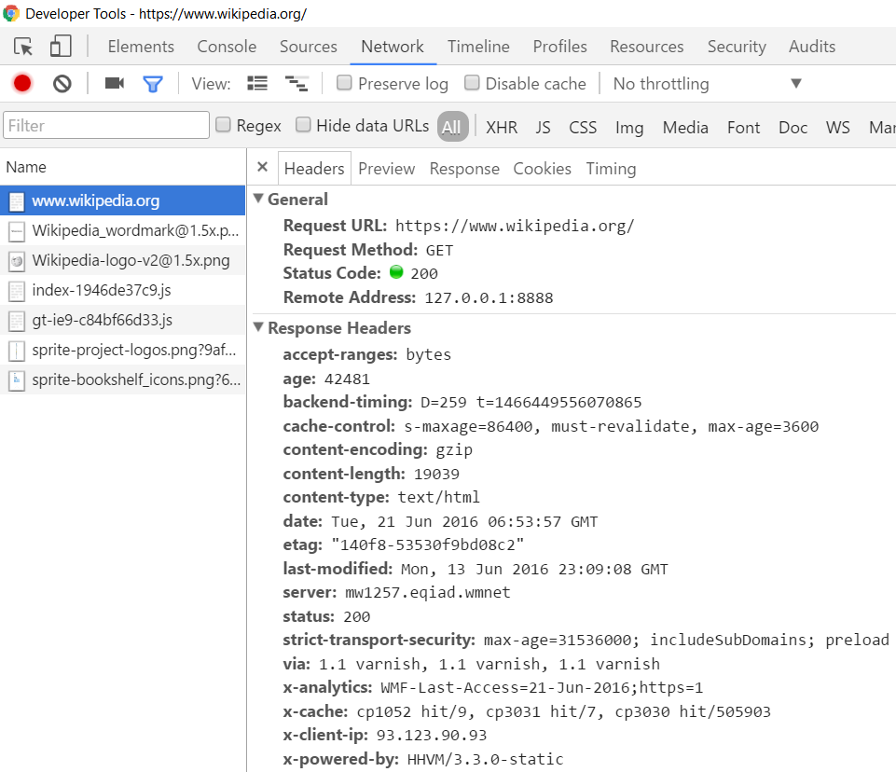
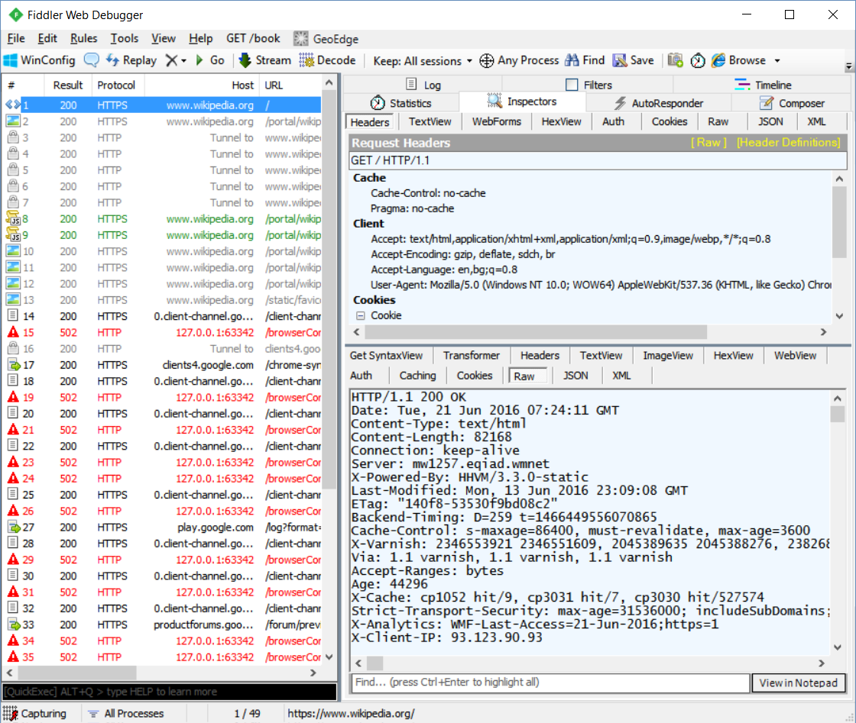
HTTP Tools for Developers
Chrome Developer Tools
Fiddler

Slide 20
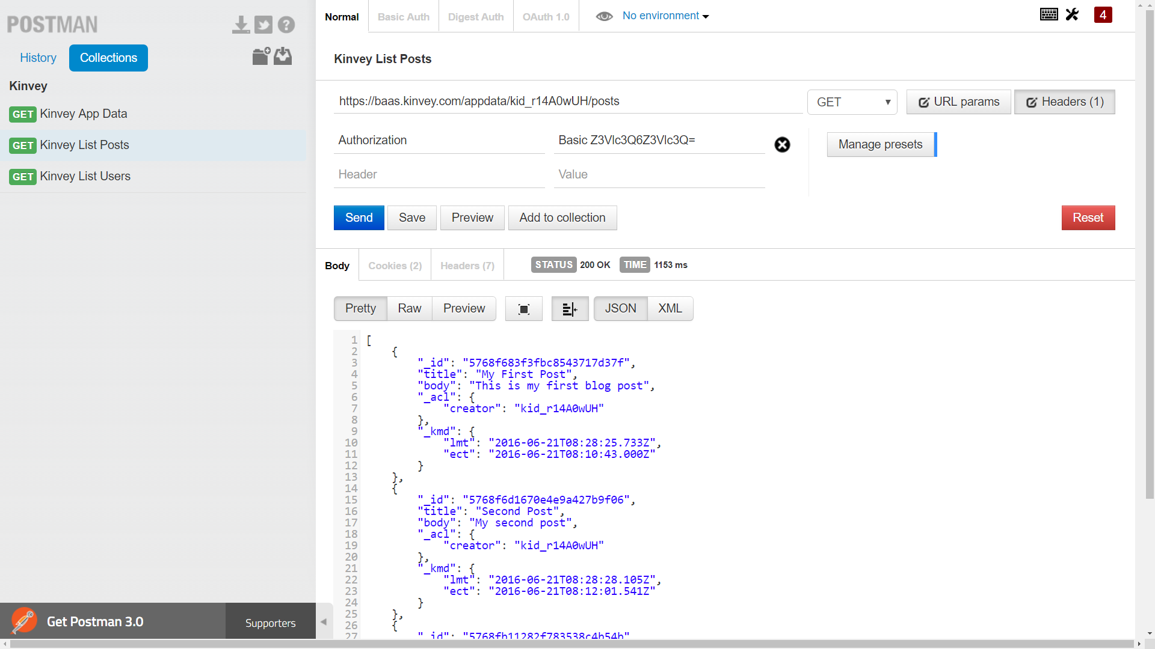
HTTP Tools for Developers
Postman REST Client

Slide 21
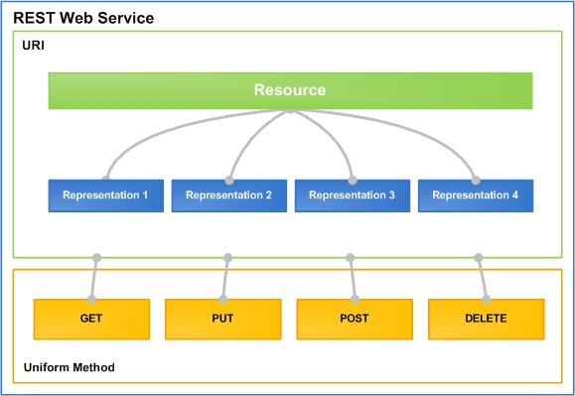
REST and RESTful Services
Representational State Transfer (REST)
Architecture for client-server communication over HTTP
Resources have URI (address)
Can be created / retrieved / modified / deleted / etc.
RESTful API / RESTful Service
Provide access to server-side resources via HTTP and REST

Slide 22

REST and RESTful Services – Example
Create a new post
POST http://some-service.org/api/posts
Get all posts / specific post
GET http://some-service.org/api/posts
GET http://some-service.org/api/posts/17
Delete existing post
DELETE http://some-service.org/api/posts/17
Replace / modify existing post
PUT / PATCH http://some-service.org/api/posts/17

Slide 23
Kinvey as JS Back-End
Kinvey is a Mobile Back-End as a Service (mBaaS)
Holds your JS / mobile app data in the cloud
Anyone can register and create app
Kinvey apps hold users and user data
Users (API for creating an account)
Data collections (CRUD operations)
Files (upload / download / delete)

Slide 24
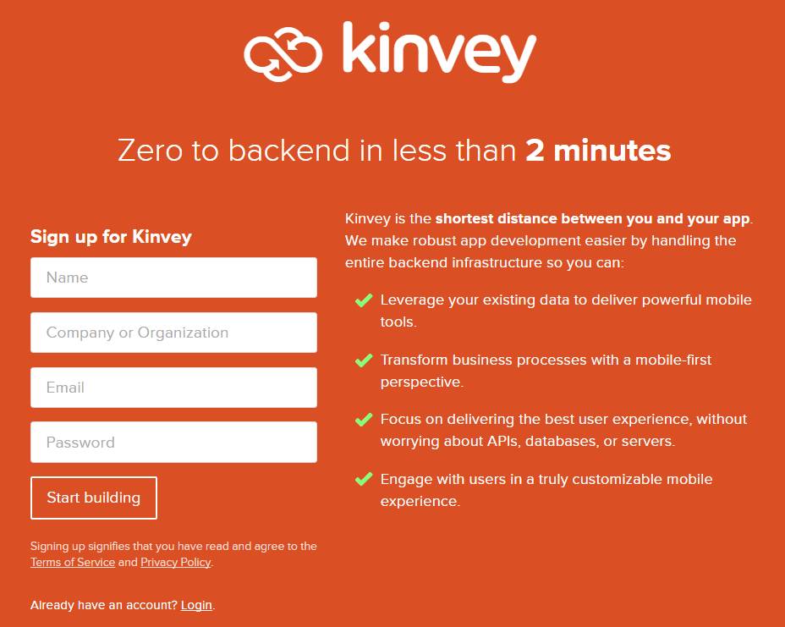
Kinvey: Registration
Create a developer account in Kinvey
https://console.kinvey.com/sign-up

Slide 25
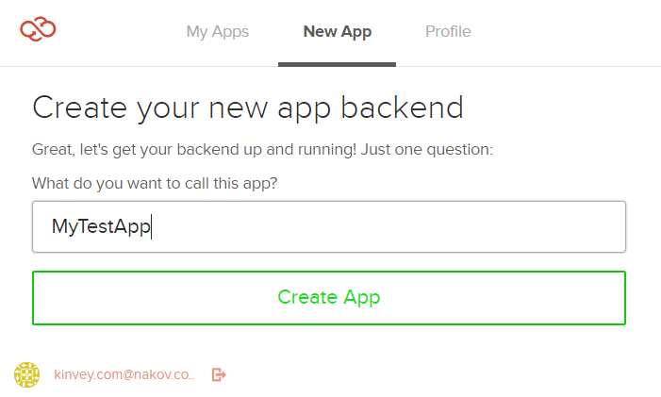
Kinvey: Create an App Backend
Create an app backend (e.g. MyTestApp)
https://console.kinvey.com/apps/new
You get APP ID + secret keys (admin account)

Slide 26
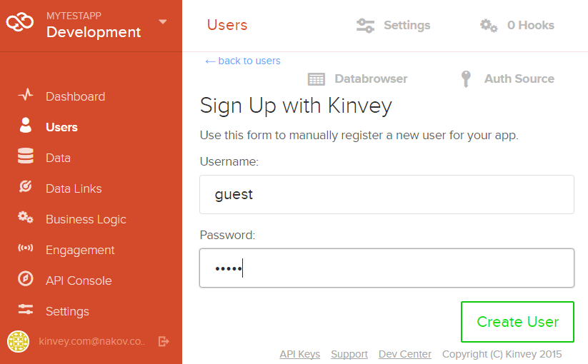
Kinvey: Create a User
Create a user (e.g. guest / guest)

Slide 27
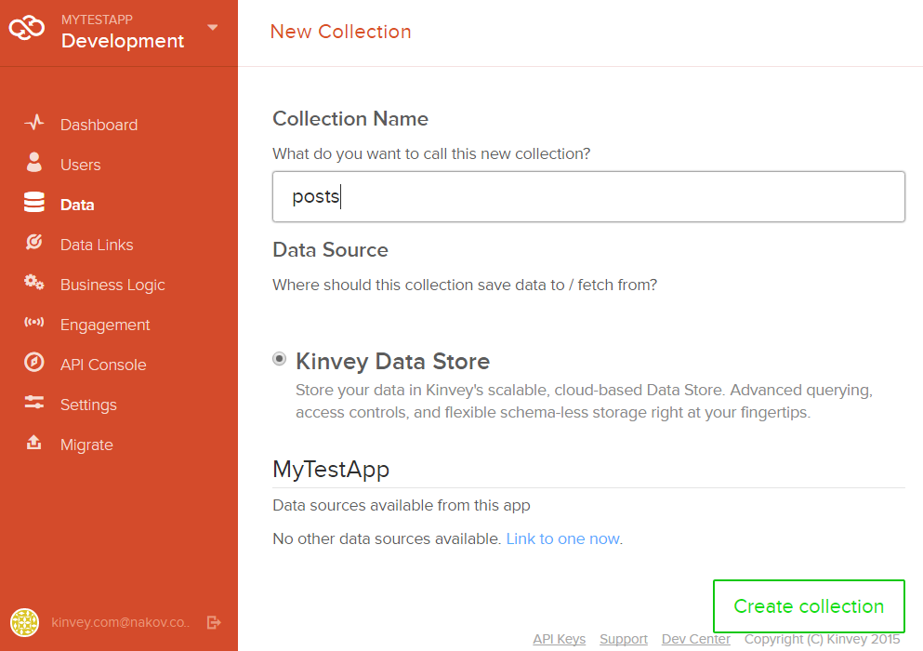
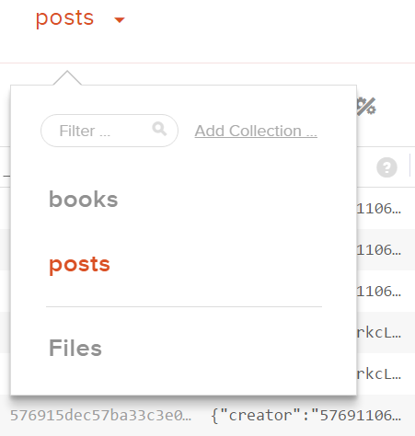
Kinvey: Create a Data Collection
Create a data collection (e.g. posts)

Slide 28
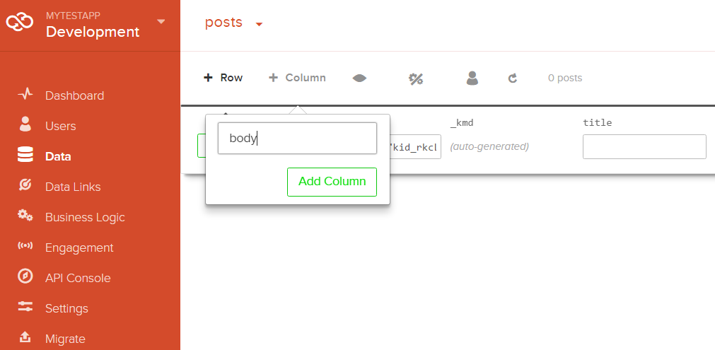
Kinvey: Create Data Columns
Create some data columns for the posts, e.g. title and body

Slide 29
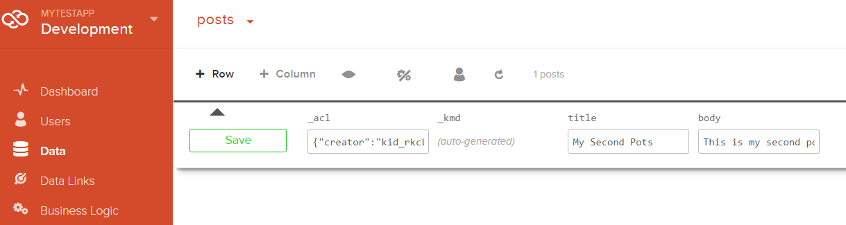
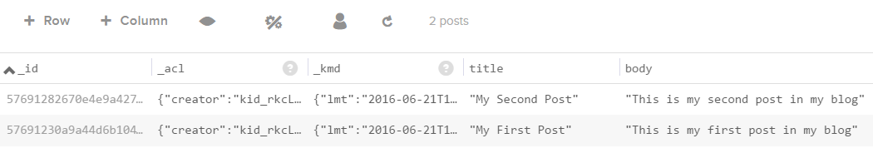
Kinvey: Create Data Rows
Create some data rows for the posts collection

Slide 30
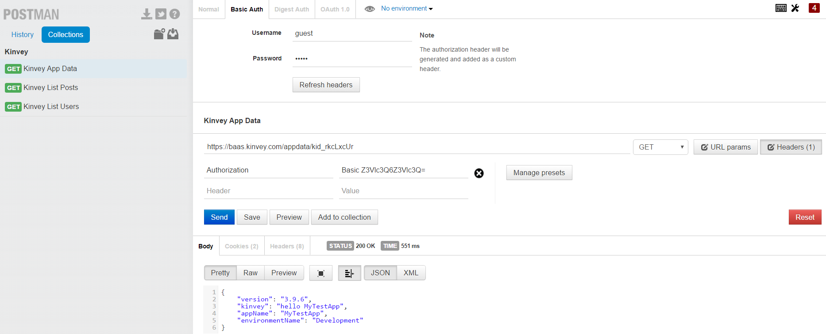

Test Your Backend with Postman
Basic authentication user: guest
pass: guest
https://baas.kinvey.com/appdata/{app_id}

Slide 31
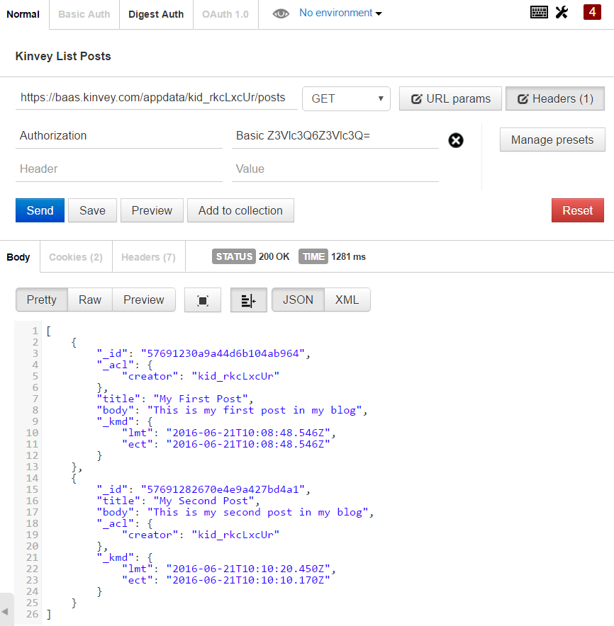
Kinvey and Postman: List Posts
URL: https://baas.kinvey.com/appdata/{app_id}/posts
Method: GET
Authentication: Basic
User: guest
Pass: guest

Slide 32
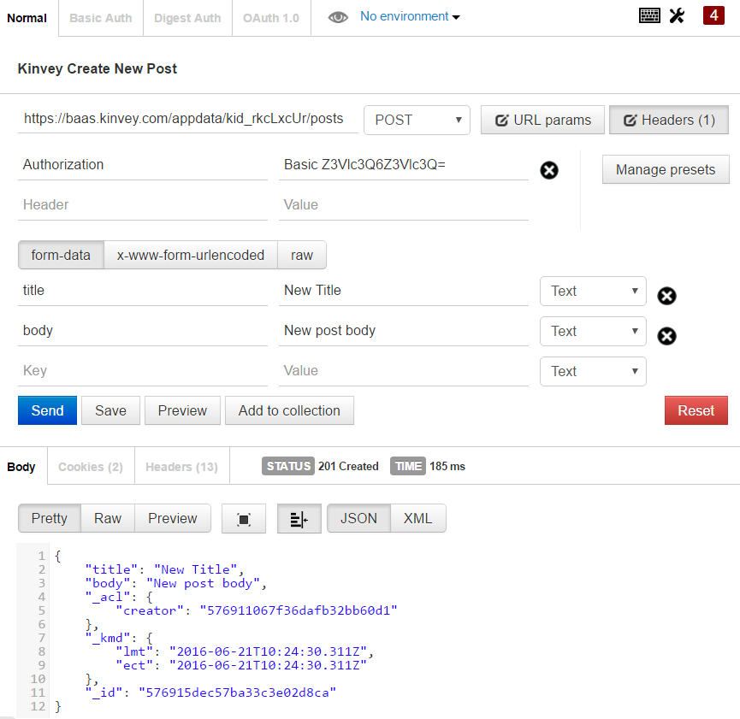
Kinvey and Postman: Create a New Post
URL: https://baas.kinvey.com/appdata/{app_id}/posts
Method: POST
Authentication: Basic
User: guest
Pass: guest
Request body
title: New Title
body: new post body

Slide 33
AJAX (Asynchronous JavaScript and XML)
AJAX allows the Web browser (JS client app)
To load server-side resource asynchronously
Invoke RESTful service and show server data
Two types of AJAX
Partial page rendering
Load HTML fragment and show it in a <div>
REST service call
Load JSON object from RESTful service and display it with JS

Slide 34
Using AJAX with jQuery
$.ajax({
method: "GET",
url: "https://some_service/…",
headers: { … },
data: { … },
success: function(data, status) {
$('body').append(JSON.stringify(data));
},
error: function(data, status) {
$('body').append(JSON.stringify(data));
}
});

Slide 35
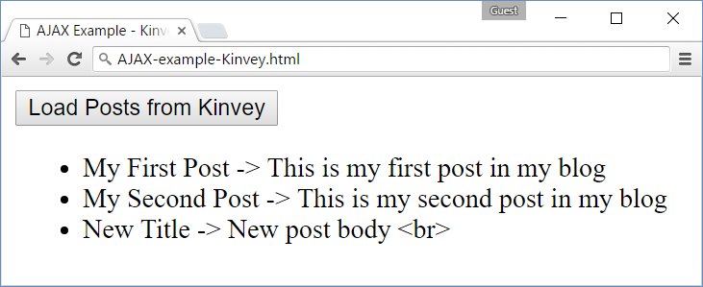
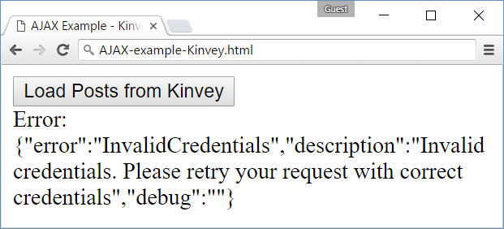
Problem: List the Posts from Kinvey
List all posts from Kinvey posts collection
Use jQuery AJAX call to Kinvey

Slide 36
Solution: Call Kinvey with AJAX and jQuery
<button id="loadPosts">Load Posts from Kinvey</button>
<script>
$('#loadPosts').click(function() {
let USERNAME = "guest", PASSWORD = "guest"
let authBase64 = btoa(USERNAME + ":" + PASSWORD)
$.ajax({
method: "GET",
url: "https://baas.kinvey.com/appdata/kid_rkcLxcUr/posts",
headers: { "Authorization": "Basic " + authBase64 },
success: showPosts,
error: showError
});
});
</script>

Slide 37
Solution: Call Kinvey with AJAX and jQuery (2)
function showPosts(data, status) {
let ul = $('<ul>')
for (let post of data) {
ul.append($('<li>').text(
post.title + " -> " + post.body));
}
$('body').append(ul);
}
function showError(data, status) {
let errorMsg = "Error: " + JSON.stringify(data);
$('body').append($('<div>').text(errorMsg));
}

Slide 38
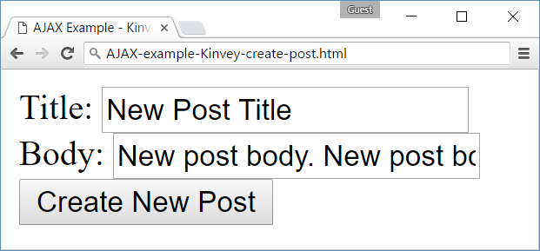
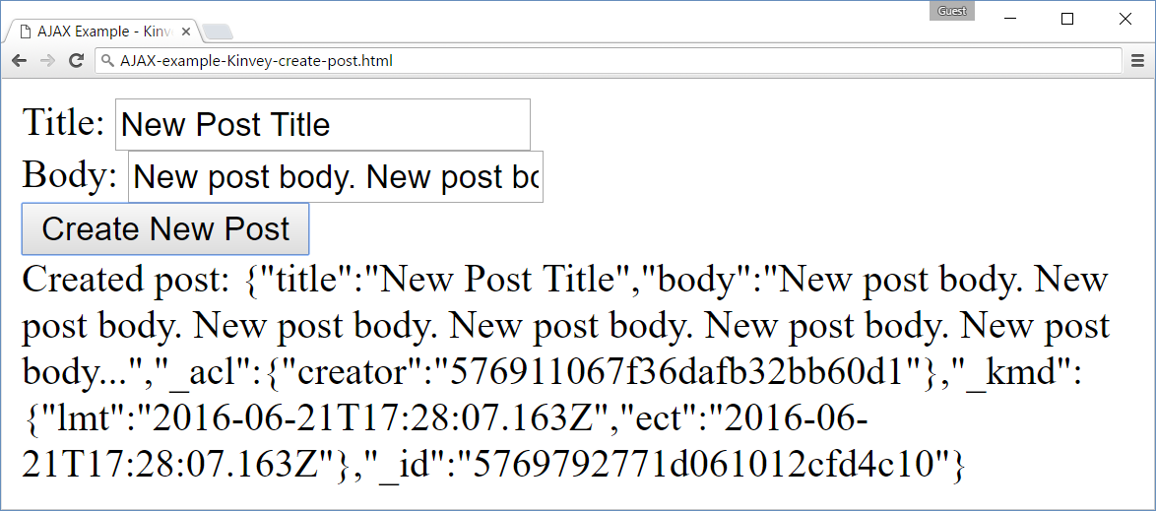
Problem: Create a New Post in Kinvey
Create a new post in the Kinvey posts collection
Use jQuery AJAX access Kinvey

Slide 39
Solution: Create a New Post in Kinvey
$('#loadPosts').click(function() {
let USERNAME = "guest", PASSWORD = "guest"
let authBase64 = btoa(USERNAME + ":" + PASSWORD)
let postData = { title: $('#newPostTitle').val(),
body: $('#newPostBody').val() }
$.ajax({
method: "POST",
url: "https://baas.kinvey.com/appdata/kid_rkcLxcUr/posts",
headers: { "Authorization": "Basic " + authBase64 },
data: postData,
success: showSuccess,
error: showError
});
});

Slide 40
Solution: Create a New Post in Kinvey (2)
Title: <input type="text" id="newPostTitle" /><br>
Body: <input type="text" id="newPostBody" /><br>
<button id="loadPosts">Create New Post</button>
function showSuccess(data, status) {
let responseMsg = "Created: " + JSON.stringify(data);
$('body').append($('<div>').text(responseMsg));
}
function showError(data, status) {
let errorMsg = "Error: " + JSON.stringify(data);
$('body').append($('<div>').text(errorMsg));
}

Slide 41


Summary
Documents in the Web browser are represented as DOM tree
JS code can traverse / edit the DOM tree
jQuery simplifies the DOM manipulations
Simplifies AJAX requests
AJAX accesses remote data via HTTP
AJAX invokes remote RESTful services
jQuery AJAX allows HTTP GET / POST / …

Slide 42








jQuery and AJAX
https://softuni.bg/courses/software-technologies

Slide 43
License
This course (slides, examples, demos, videos, homework, etc.) is licensed under the "Creative Commons Attribution-NonCommercial-ShareAlike 4.0 International" license

Slide 44






Free Trainings @ Software University
Software University Foundation – softuni.org
Software University – High-Quality Education, Profession and Job for Software Developers
softuni.bg
Software University @ Facebook
facebook.com/SoftwareUniversity
Software University @ YouTube
youtube.com/SoftwareUniversity
Software University Forums – forum.softuni.bg

